Slide 1
Module 1
Review of Java

Slide 2
Language Fundamentals - Variables
local variable
instance variable
Class/static variable

Slide 3
Data Types
Primitive data types - byte, short, int, long, float, double, boolean and char
Non-primitive data types –
String, Arrays, Interfaces and Classes

Slide 4
Type casting
Type casting is when assign a value of one primitive data type to another type.
In Java, there are two types of casting:
Widening Casting (automatically) - converting a smaller type to a larger type size byte -> short -> char -> int -> long -> float -> double Narrowing Casting (manually) - converting a larger type to a smaller size type double -> float -> long -> int -> char -> short -> byte

Slide 5
Operators
Operator is a symbol that is used to perform operations on variables and values
According to number of operands. – Unary(-,!,++,--,inverting boolean value), Binary, Ternary(&:)
Arithmetic operators - +,-,*,/,%,++,--
Relational operators - ==,!=,<,>,<=,>=
Logical operators - !,&&,||
Bitwise operators - &,|,^,~,<<,>>,>>>
Updating /Assignment operator - =,+=,-=,*=,/=,%=,&=,|=,^=,>>=,<<=

Slide 6
Expression/Formula
Variables or values(constants) are connected by operator
Evaluate to return a result
Arithmetic expression
Relational expression
Logical expression

Slide 7
Precedence of operators
Operator Type | Category | Precedence
Unary | postfix | expr++ expr--
 | prefix | ++expr --expr +expr -expr ~ !
Arithmetic | multiplicative | * / %
 | additive | + -
Shift | shift | << >> >>>
Relational | comparison | < > <= >= instanceof
 | equality | == !=
Bitwise | bitwise AND | &
 | bitwise exclusive OR | ^
 | bitwise inclusive OR | |
Logical | logical AND | &&
 | logical OR | ||
Ternary | ternary | ? :
Assignment | assignment | = += -= *= /= %= &= ^= |= <<= >>= >>>=

Slide 8
Statements - Comments
not executed by the compiler and interpreter.
Comments are used to make the program more readable by adding the details of the code.
It makes easy to maintain the code and to find the errors easily.
The comments can be used to provide information or explanation about the variable, method, class, or any statement.
It can also be used to prevent the execution of program code while testing the alternative code.
Single Line Comment - comment only one line of the code. It is the widely used and easiest way of commenting the statements.Single line comments starts with two forward slashes (//). Any text in front of // is not executed by Java.
Multi Line Comment - to comment multiple lines of code. It can be used to explain a complex code snippet or to comment multiple lines of code at a time (as it will be difficult to use single-line comments there). Multi-line comments are placed between /* and */. Any text between /* and */ is not executed by Java.v
Documentation comments are usually used to write large programs for a project or software application as it helps to create documentation API. These APIs are needed for reference, i.e., which classes, methods, arguments, etc., are used in the code. To create documentation API, we need to use the javadoc tool. The documentation comments are placed between /** and */.

Slide 9
Decision making statements
If statement
Simple if statement
if(condition) {
statement 1; //executes when condition is true
}
2. if-else statement
if(condition) {
statement 1; //executes when condition is true
}
else{
statement 2; //executes when condition is false
}

Slide 10
3. if-else-if ladder
if(condition 1) {
statement 1; //executes when condition 1 is true
}
else if(condition 2) {
statement 2; //executes when condition 2 is true
}
else {
statement 2; //executes when all the conditions are false
}

Slide 11
4. Nested if-statement
if(condition 1) {
statement 1; //executes when condition 1 is true
if(condition 2) {
statement 2; //executes when condition 2 is true
}
else{
statement 2; //executes when condition 2 is false
}
}

Slide 12
Switch statement – Multi conditional
switch (expression){
case value 1:
statement 1;
break;
.
.
.
case value N:
statement N;
break;
default:
default statement;
}
The case variables can be int, short, byte, char, or enumeration. String type is also supported since version 7 of Java
Cases cannot be duplicate
Default statement is executed when any of the case doesn't match the value of expression. It is optional.
Break statement terminates the switch block when the condition is satisfied. It is optional, if not used, next case is executed.
While using switch statements, we must notice that the case expression will be of the same type as the variable. However, it will also be a constant value.

Slide 13
Loop statements
for loop
while loop
do-while loop

Slide 14
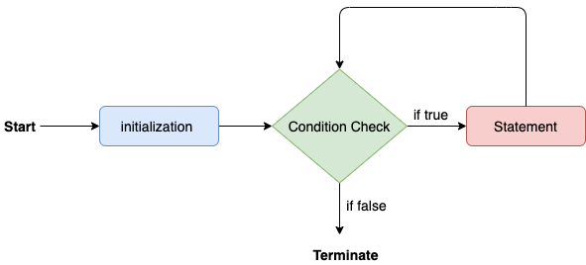
for statement
for(initialization, condition, increment/decrement) {
//block of statements
}
public class Calculattion {
public static void main(String[] args) {
// TODO Auto-generated method stub
int sum = 0;
for(int j = 1; j<=10; j++) {
sum = sum + j;
}
System.out.println("The sum of first 10 natural numbers is " + sum);
}

Slide 15
for-each loop
for(data_type var : array_name/collection_name){
//statements
}
public class Calculation {
public static void main(String[] args) {
// TODO Auto-generated method stub
String[] names = {"Java","C","C++","Python","JavaScript"};
System.out.println("Printing the content of the array names:\n");
for(String name:names) {
System.out.println(name);
}
}

Slide 16
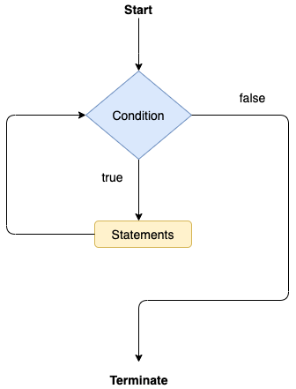
while loop
while(condition){
//looping statements
}
public class Calculation {
public static void main(String[] args) {
// TODO Auto-generated method stub
int i = 0;
System.out.println("Printing the list of first 10 even numbers \n");
while(i<=10) {
System.out.println(i);
i = i + 2;
}
}

Slide 17
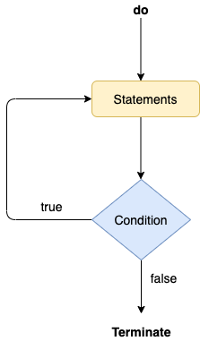
do-while loop
do
{
//statements
} while (condition);
public class Calculation {
public static void main(String[] args) {
// TODO Auto-generated method stub
int i = 0;
System.out.println("Printing the list of first 10 even numbers \n");
do {
System.out.println(i);
i = i + 2;
}while(i<=10);
}
}

Slide 18
Nested Loops
If a loop exists inside the body of another loop, it's called a nested loop
May be many forms
the nested for loop. Outer for loop contain inner for loop
class Main { public static void main(String[] args) { int weeks = 3; int days = 7; // outer loop prints weeks for (int i = 1; i <= weeks; ++i) { System.out.println("Week: " + i); // inner loop prints days for (int j = 1; j <= days; ++j) { System.out.println(" Day: " + j); } } } }
for loop inside the while loop
class Main { public static void main(String[] args) { int weeks = 3; int days = 7; int i = 1; // outer loop while (i <= weeks) { System.out.println("Week: " + i); // inner loop for (int j = 1; j <= days; ++j) { System.out.println(" Days: " + j); } ++i; } } }

Slide 19
break and continue Inside Nested Loops
use a break statement inside the inner loop, it terminates the inner loop but not the outer loop.
class Main { public static void main(String[] args) { int weeks = 3; int days = 7; // outer loop for(int i = 1; i <= weeks; ++i) { System.out.println("Week: " + i); // inner loop for(int j = 1; j <= days; ++j) { // break inside the inner loop if(i == 2) { break; } System.out.println(" Days: " + j); } } } }
use a continue statement inside the inner loop, it skips the current iteration of the inner loop only. The outer loop is unaffected.
class Main { public static void main(String[] args) { int weeks = 3; int days = 7; // outer loop for(int i = 1; i <= weeks; ++i) { System.out.println("Week: " + i); // inner loop for(int j = 1; j <= days; ++j) { // continue inside the inner loop if(j % 2 != 0) { continue; } System.out.println(" Days: " + j); } } } }

Slide 20
Break statement
When a break statement is encountered inside a loop, the loop is immediately terminated and the program control resumes at the next statement following the loop.
The Java break statement is used to break loop or switch statement. It breaks the current flow of the program at specified condition. In case of inner loop, it breaks only inner loop.
We can use Java break statement in all types of loops such as for loop, while loop and do-while loop.

Slide 21
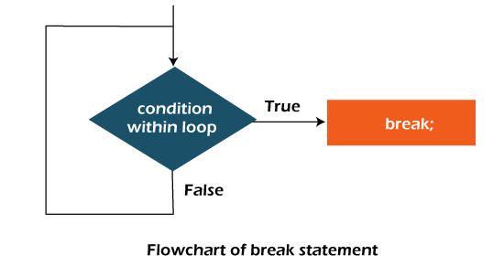
/Java Program to demonstrate the use of break statement
//inside the for loop.
public class BreakExample {
public static void main(String[] args) {
//using for loop
for(int i=1;i<=10;i++){
if(i==5){
//breaking the loop
break;
}
System.out.println(i);
}
}
}

Slide 22
Break Statement with Inner Loop
It breaks inner loop only if you use break statement inside the inner loop
//Java Program to illustrate the use of break statement
//inside an inner loop
public class BreakExample2 {
public static void main(String[] args) {
//outer loop
for(int i=1;i<=3;i++){
//inner loop
for(int j=1;j<=3;j++){
if(i==2&&j==2){
//using break statement inside the inner loop
break;
}
System.out.println(i+" "+j);
}
}
}
}

Slide 23
Break Statement with Labeled For Loop
use break statement with a label. The feature is introduced since JDK 1.5. So, we can break any loop in Java now whether it is outer or inner loop.
//Java Program to illustrate the use of continue statement
//with label inside an inner loop to break outer loop
public class BreakExample3 {
public static void main(String[] args) {
aa:
for(int i=1;i<=3;i++){
bb:
for(int j=1;j<=3;j++){
if(i==2&&j==2){
//using break statement with label
break aa;
}
System.out.println(i+" "+j);
}
}
}
}

Slide 24
Break Statement in while loop
//Java Program to demonstrate the use of break statement
//inside the while loop.
public class BreakWhileExample {
public static void main(String[] args) {
//while loop
int i=1;
while(i<=10){
if(i==5){
//using break statement
i++;
break;//it will break the loop
}
System.out.println(i);
i++;
}
}
}

Slide 25
Break Statement in do-while loop
//Java Program to demonstrate the use of break statement
//inside the Java do-while loop.
public class BreakDoWhileExample {
public static void main(String[] args) {
//declaring variable
int i=1;
//do-while loop
do{
if(i==5){
//using break statement
i++;
break;//it will break the loop
}
System.out.println(i);
i++;
}while(i<=10);
}
}

Slide 26
Continue Statement
The continue statement is used in loop control structure when you need to jump to the next iteration of the loop immediately. It can be used with for loop or while loop.
The Java continue statement is used to continue the loop. It continues the current flow of the program and skips the remaining code at the specified condition. In case of an inner loop, it continues the inner loop only.
We can use Java continue statement in all types of loops such as for loop, while loop and do-while loop.

Slide 27
//Java Program to demonstrate the use of continue statement
//inside the for loop.
public class ContinueExample {
public static void main(String[] args) {
//for loop
for(int i=1;i<=10;i++){
if(i==5){
//using continue statement
continue;//it will skip the rest statement
}
System.out.println(i);
}
}
}

Slide 28
Continue Statement with Inner Loop
It continues inner loop only if you use the continue statement inside the inner loop
//Java Program to illustrate the use of continue statement
//inside an inner loop
public class ContinueExample2 {
public static void main(String[] args) {
//outer loop
for(int i=1;i<=3;i++){
//inner loop
for(int j=1;j<=3;j++){
if(i==2&&j==2){
//using continue statement inside inner loop
continue;
}
System.out.println(i+" "+j);
}
}
}
}

Slide 29
Continue Statement with Labelled For Loop
use continue statement with a label. This feature is introduced since JDK 1.5. So, we can continue any loop in Java now whether it is outer loop or inner.
//Java Program to illustrate the use of continue statement
//with label inside an inner loop to continue outer loop
public class ContinueExample3 {
public static void main(String[] args) {
aa:
for(int i=1;i<=3;i++){
bb:
for(int j=1;j<=3;j++){
if(i==2&&j==2){
//using continue statement with label
continue aa;
}
System.out.println(i+" "+j);
}
}
}
}

Slide 30
Continue Statement in while loop
//Java Program to demonstrate the use of continue statement
//inside the while loop.
public class ContinueWhileExample {
public static void main(String[] args) {
//while loop
int i=1;
while(i<=10){
if(i==5){
//using continue statement
i++;
continue;//it will skip the rest statement
}
System.out.println(i);
i++;
}
}
}

Slide 31
Continue Statement in do-while Loop
//Java Program to demonstrate the use of continue statement
//inside the Java do-while loop.
public class ContinueDoWhileExample {
public static void main(String[] args) {
//declaring variable
int i=1;
//do-while loop
do{
if(i==5){
//using continue statement
i++;
continue;//it will skip the rest statement
}
System.out.println(i);
i++;
}while(i<=10);
}
}

Slide 32
Method
a collection of statements/instructions that are grouped together to perform an operation/task.
a block of code which only runs when it is called.
to achieve the reusability of code.
provides the easy modification and readability of code, just by adding or removing a chunk of code.

Slide 33
Components of method
Create a Method
Method declaration - provides information about method attributes, such as visibility, return-type, name, and arguments.
Method definition – block of statements define a task
Call a Method – invoking the method with actual arguments.

Slide 34
Example
import java.util.Scanner;
public class EvenOdd {
public static void main (String args[]) {
Scanner scan=new Scanner(System.in);
System.out.print("Enter the number: ");
int num=scan.nextInt();
findEvenOdd(num); //method calling
}
//user defined method
public static void findEvenOdd(int num) { //method body
if(num%2==0)
System.out.println(num+" is even");
else
System.out.println(num+" is odd");
}
}

Slide 35
static
a method that belongs to a class rather than an instance of a class is known as a static method.
static method is that we can call it without creating an object.
It can access static data members and also change the value of it. It is used to create an instance method. It is invoked by using the class name.

Slide 36
Instance method/non static method
The method of the class is known as an instance method.
It is a non-static method defined in the class.
Before calling or invoking the instance method, it is necessary to create an object of its class.

Slide 37
public class InstanceMethodExample {
public static void main(String [] args) {
//Creating an object of the class
InstanceMethodExample obj = new InstanceMethodExample();
//invoking instance method
System.out.println("The sum is: "+obj.add(12, 13));
}
int s;
//user-defined method because we have not used static keyword
public int add(int a, int b) {
s = a+b;
//returning the sum
return s;
}
}

Slide 38
Passing Parameters by Value/call by value
While working under calling process, arguments is to be passed. These should be in the same order as their respective parameters in the method specification. Parameters can be passed by value or by reference.
Passing Parameters by Value means calling a method with a parameter. Through this, the argument value is passed to the parameter.
The changes being done in the called method, is not affected in the calling method.
public class Example {
int a = 10;
void call(int a) {
// this local variable a is subject to change in its value
a = a+10;
}
public static void main(String[] args) {
Example eg = new Example();
System.out.println("Before call-by-value: " + eg.a);
eg.call(50510);
System.out.println("After call-by-value: " + eg.a);
}
}

Slide 39
Pass by reference
to pass any object of a class using pass-by-reference.
public class Example {
/*
* The original value of 'a' will be changed as we are trying
* to pass the objects. Objects are passed by reference.
*/
int a = 10;
void call(Example eg) {
eg.a = eg.a+10;
}
public static void main(String[] args) {
Example eg = new Example();
System.out.println("Before call-by-reference: " + eg.a);
// passing the object as a value using pass-by-reference
eg.call(eg);
System.out.println("After call-by-reference: " + eg.a);
}
}

Slide 40
Finalize method

Slide 41
Class
A class is a group of similar objects which have common properties. It is a template or blueprint from which objects are created. It is a logical entity. It can't be physical.
A class in Java can contain: class <class_name> {
Fields /instance variable field;
Methods method;
Constructors }
Blocks
Nested class and interface
Example class Student{
int id; //field or data member or instance variable
String name;
String branch;
}

Slide 42
Object
Instance of class
a real world entity
A physical entity
Create through new keyword Ex: Student s1 = new Student();
allocates memory when it is created.
Object is created many times as per requirement.
Class: Human Object: Man, Woman
Class: Fruit Object: Apple, Banana, Mango, Guava wtc.

Slide 43
Inside a class
Instance variable
A variable which is created inside the class but outside the method
doesn't get memory at compile time.
It gets memory at runtime when an object or instance is created.
attributes of a class
Method
function which is used to expose the behavior of an object.

Slide 44
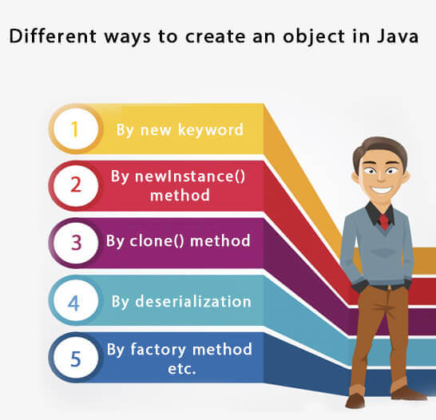
Create an object

Slide 45
Constructor
a block of codes similar to the method. special type of method which is used to initialize the object.
It is called when an instance of the classis created
memory for the object is allocated in the memory.
Every time an object is created using the new() keyword, at least one constructor is called.
It calls a default constructor if there is no constructor available in the class.
Constructor name must be the same as its class name
A Constructor must have no explicit return type
A Java constructor cannot be abstract, static, final, and synchronized

Slide 46
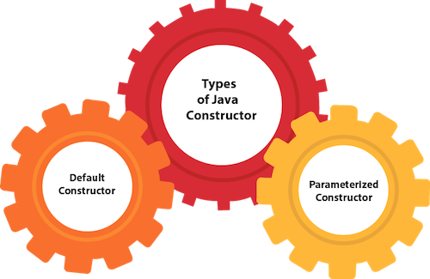
Constructor types

Slide 47
Example
class Student {
int rollNo;
String firstName;
public Student() {
rollNo=1;
firstName=””;
}
public Student(int no,String fn) {
rollNo=rn;
firstName=fn;
}
}
public class temp {[
public static void main(String args[]) {
Student s1 = new Student();
Student s2 = new Student(1,”God”);
}
}

Slide 48
Constructor overloading
Constructor overloading is a technique of having more than one constructor with different parameter lists. They are arranged in a way that each constructor performs a different task. They are differentiated by the compiler by the number of parameters in the list and their types.
class Student
int id;
String name;
int age;
//creating two arg constructor
Student(int i,String n){
id = i;
name = n;
}
//creating three arg constructor
Student(int i,String n,int a){
id = i;
name = n;
age=a;
}
void display(){System.out.println(id+" "+name+" "+age);}
public static void main(String args[]){
Student s1 = new Student(111,"Karan");
Student s2 = new Student(222,"Aryan",25);
s1.display();
s2.display();
}
}

Slide 49
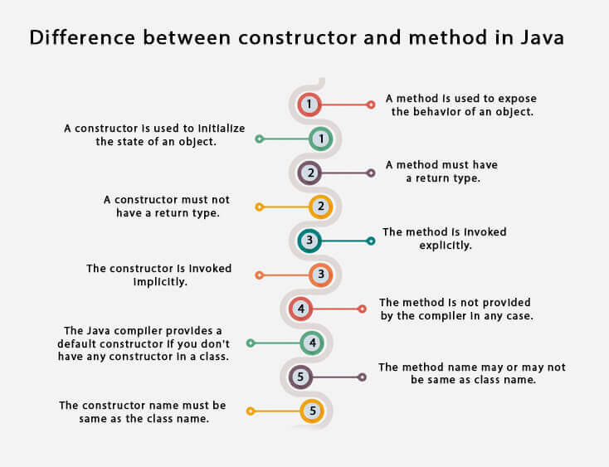
Distinguish between Constructor and Method

Slide 50
Copy Constructor
There is no copy constructor in Java. However, we can copy the values from one object to another like copy constructor in C++.
There are many ways to copy the values of one object into another in Java. They are:
By constructor
By assigning the values of one object into another
By clone() method of Object class

Slide 51
Example
class Student{
int id;
String name;
//constructor to initialize integer and string
Student(int i,String n){
id = i;
name = n;
}
//constructor to initialize another object
Student(Student s){
id = s.id;
name =s.name;
}
void display(){System.out.println(id+" "+name);}
public static void main(String args[]){
Student s1 = new Student(111,"Karan");
Student s2 = new Student(s1);
s1.display();
s2.display();
}
}

Slide 52
Copy values without constructor
copy the values of one object into another by assigning the objects values to another object. In this case, there is no need to create the constructor.
class Student{
int id;
String name;
Student(int i,String n){
id = i;
name = n;
}
Student(){}
void display(){System.out.println(id+" "+name);}
public static void main(String args[]){
Student s1 = new Student(111,"Karan");
Student s2 = new Student();
s2.id=s1.id;
s2.name=s1.name;
s1.display();
s2.display();
}
}

Slide 53
Static
The static keyword in Java is used for memory management mainly.
We can apply static keyword with variables, methods, blocks and nested classes.
The static keyword belongs to the class than an instance of the class.
The static can be:
Variable (also known as a class variable)
Method (also known as a class method)
Block
Nested class

Slide 54
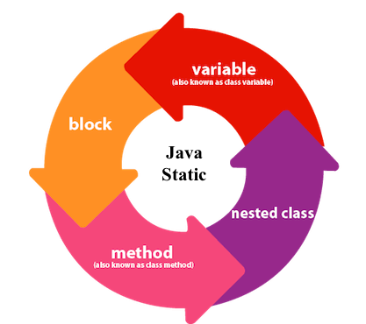
Static variable
declare any variable as static, it is known as a static variable.
The static variable can be used to refer to the common property of all objects (which is not unique for each object), for example, the company name of employees, college name of students, etc.
The static variable gets memory only once in the class area at the time of class loading.
Advantages of static variable makes your program memory efficient (i.e., it saves memory).

Slide 55
Example
//Java Program to demonstrate the use of static variable
class Student{
int rollno;//instance variable
String name;
static String college ="ITS";//static variable
//constructor
Student(int r, String n){
rollno = r;
name = n;
}
//method to display the values
void display (){System.out.println(rollno+" "+name+" "+college);}
}
//Test class to show the values of objects
public class TestStaticVariable1{
public static void main(String args[]){
Student s1 = new Student(111,"Karan");
Student s2 = new Student(222,"Aryan");
//we can change the college of all objects by the single line of code
//Student.college="BBDIT";
s1.display();
s2.display();
}
}

Slide 56
static method
apply static keyword with any method, it is known as static method.
A static method belongs to the class rather than the object of a class.
A static method can be invoked without the need for creating an instance of a class.
A static method can access static data member and can change the value of it.
//Java Program to get the cube of a given number using the static method
class Calculate{
static int cube(int x){
return x*x*x;
}
public static void main(String args[]){
int result=Calculate.cube(5);
System.out.println(result);
}
}

Slide 57
static block
Is used to initialize the static data member.
It is executed before the main method at the time of classloading.
Example of static block
class A2{
static{System.out.println("static block is invoked");}
public static void main(String args[]){
System.out.println("Hello main");
}
}

Slide 58
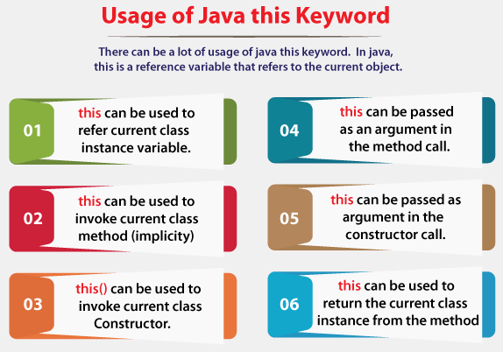
this keyword
this is a reference variable that refers to the current object.

Slide 59
this: to refer current class instance variable
The this keyword can be used to refer current class instance variable. If there is ambiguity between the instance variables and parameters, this keyword resolves the problem of ambiguity.
class Student{
int rollno;
String name;
float fee;
Student(int rollno,String name,float fee){
this.rollno=rollno;
this.name=name;
this.fee=fee;
}
void display(){System.out.println(rollno+" "+name+" "+fee);}
}
class TestThis2{
public static void main(String args[]){
Student s1=new Student(111,"ankit",5000f);
Student s2=new Student(112,"sumit",6000f);
s1.display();
s2.display();
}}

Slide 60
this: to refer current class instance variable
class Student{
int rollno;
String name;
float fee;
Student(int rollno,String name,float fee){
this.rollno=rollno;
this.name=name;
this.fee=fee;
}
void display(){System.out.println(rollno+" "+name+" "+fee);}
}
class TestThis2{
public static void main(String args[]){
Student s1=new Student(111,"ankit",5000f);
Student s2=new Student(112,"sumit",6000f);
s1.display();
s2.display();
}}

Slide 61
this: to invoke current class method
invoke the method of the current class by using the this keyword. If you don't use the this keyword, compiler automatically adds this keyword while invoking the method.
class A{
void m(){System.out.println("hello m");}
void n(){
System.out.println("hello n");
//m();//same as this.m()
this.m();
}
}
class TestThis4{
public static void main(String args[]){
A a=new A();
a.n();
}}

Slide 62
this() : to invoke current class constructor
The this() constructor call can be used to invoke the current class constructor. It is used to reuse the constructor. In other words, it is used for constructor chaining.
class A{
A(){System.out.println("hello a");}
A(int x){
this();
System.out.println(x);
}
}
class TestThis5{
public static void main(String args[]){
A a=new A(10);
}}

Slide 63
this: to pass as an argument in the method
The this keyword can also be passed as an argument in the method. It is mainly used in the event handling.
class S2{
void m(S2 obj){
System.out.println("method is invoked");
}
void p(){
m(this);
}
public static void main(String args[]){
S2 s1 = new S2();
s1.p();
}
}

Slide 64
this: to pass as argument in the constructor call
the this keyword in the constructor also. It is useful if we have to use one object in multiple classes.
class B{
A4 obj;
B(A4 obj){
this.obj=obj;
}
void display(){
System.out.println(obj.data);//using data member of A4 class
}
}
class A4{
int data=10;
A4(){
B b=new B(this);
b.display();
}
public static void main(String args[]){
A4 a=new A4();
}
}

Slide 65
this keyword can be used to return current class instance
return this keyword as an statement from the method. In such case, return type of the method must be the class type (non-primitive).
class A{
A getA(){
return this;
}
void msg(){System.out.println("Hello java");}
}
class Test1{
public static void main(String args[]){
new A().getA().msg();
}
}

Slide 66
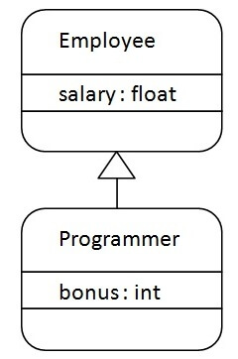
Inheritance
a mechanism in which one object acquires all the properties and behaviors of a parent object.
create new classes that are built upon existing classes.
subclass (child/derived) - the class that inherits from another class
superclass (parent/base) - the class being inherited from
represents the IS-A relationship which is also known as a parent-child relationship.
use - For Method Overriding (so runtime polymorphism can be achieved).
- For Code Reusability.
Syntax - class Subclass-name extends Superclass-name
{
//methods and fields
}
class Employee{
float salary=40000;
}
class Programmer extends Employee{
int bonus=10000;
public static void main(String args[]){
Programmer p=new Programmer();
System.out.println("Programmer salary is:"+p.salary);
System.out.println("Bonus of Programmer is:"+p.bonus);
}
}

Slide 67
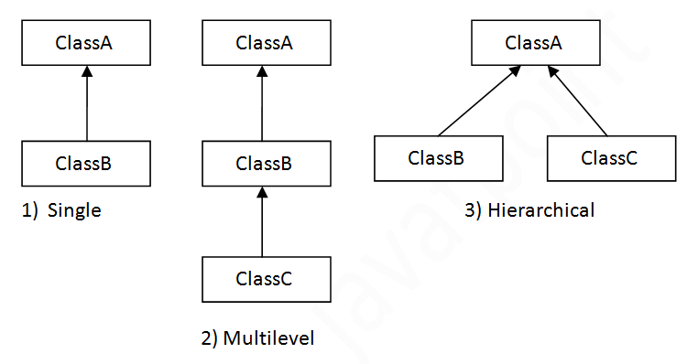
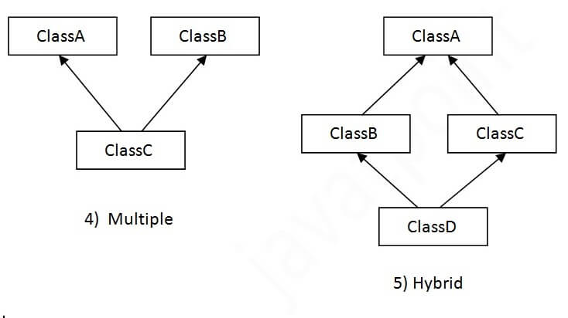
Types of inheritance
single, multilevel and hierarchical.
multiple and hybrid inheritance is supported through interface only.

Slide 68
Single Inheritance
When a class inherits another class, it is known as a single inheritance.
class A {
void msg() {
sop(“A”);
}
class B extends A {
void show() {
sop(“B”);
}
public class temp {
public static void main(String args[]) {
B b = new B();
b.msg();
b.show();
}
}

Slide 69
Multilevel Inheritance
When there is a chain of inheritance, it is known as multilevel inheritance.
class A {
void msg() {
sop(“A”);
}
class B extends A {
void show() {
sop(“B”);
}
class C extends B {
void disp() {
sop(“C”);
}
public class temp {
public static void main(String args[]) {
C c = new C();
c.msg();
c.show();
c.disp();
}
}

Slide 70
Hierarchical Inheritance
When two or more classes inherits a single class, it is known as hierarchical inheritance.
class A {
void msg() {
sop(“A”);
}
class B extends A {
void show() {
sop(“B”);
}
class C extends A {
void disp() {
sop(“C”);
}
public class temp {
public static void main(String args[]) {
C c = new C();
c.msg();
c.show();
c.disp();
}
}

Slide 71
Why multiple inheritance is not supported in java?
To reduce the complexity and simplify the language, multiple inheritance is not supported in java. Consider a scenario where A, B, and C are three classes. The C class inherits A and B classes. If A and B classes have the same method and you call it from child class object, there will be ambiguity to call the method of A or B class.
Since compile-time errors are better than runtime errors, Java renders compile-time error if you inherit 2 classes. So whether you have same method or different, there will be compile time error.
class A{
msg(){System.out.println("Hello");}
}
class B{
void msg(){System.out.println("Welcome");}
}
class C extends A,B{//suppose if it were
public static void main(String args[]){
C obj=new C();
obj.msg();//Now which msg() method would be invoked?
}
}

Slide 72
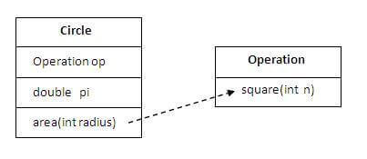
Aggregation
If a class have an entity reference, it is known as Aggregation. Aggregation represents HAS-A relationship.
Why use Aggregation? For Code Reusability.
class Operation{
int square(int n){
return n*n;
}
}
class Circle{
Operation op;//aggregation
double pi=3.14;
double area(int radius){
op=new Operation();
int rsquare=op.square(radius);//code reusability (i.e. delegates the method call).
return pi*rsquare;
}
public static void main(String args[]){
Circle c=new Circle();
double result=c.area(5);
System.out.println(result);
}
}

Slide 73
Method Overloading
If a class has multiple methods having same name but different in parameters, it is known as Method Overloading. not possible by changing the return type of the method only. (because of ambiguity)
Advantage - increases the readability of the program.
Different ways to overload the method
By changing number of arguments
By changing the data type

Slide 74
Method Overloading: changing no. of arguments
In this example, we have created two methods, first add() method performs addition of two numbers and second add method performs addition of three numbers.
In this example, we are creating static methods so that we don't need to create instance for calling methods.
class Adder{
static int add(int a,int b){return a+b;}
static int add(int a,int b,int c){return a+b+c;}
}
class TestOverloading1{
public static void main(String[] args){
System.out.println(Adder.add(11,11));
System.out.println(Adder.add(11,11,11));
}
}

Slide 75
Method Overloading: changing data type of arguments
In this example, we have created two methods that differs in data type. The first add method receives two integer arguments and second add method receives two double arguments.
class Adder{
static int add(int a, int b){return a+b;}
static double add(double a, double b){return a+b;}
}
class TestOverloading2{
public static void main(String[] args){
System.out.println(Adder.add(11,11));
System.out.println(Adder.add(12.3,12.6));
}}

Slide 76
Method Overloading and Type Promotion
One type is promoted to another implicitly if no matching datatype is found.
class OverloadingCalculation1{
void sum(int a,long b){System.out.println(a+b);}
void sum(int a,int b,int c){System.out.println(a+b+c);}
public static void main(String args[]){
OverloadingCalculation1 obj=new OverloadingCalculation1();
obj.sum(20,20);//now second int literal will be promoted to long
obj.sum(20,20,20);
}
}

Slide 77
Method Overloading with Type Promotion if matching found
If there are matching type arguments in the method, type promotion is not performed.
class OverloadingCalculation2{
void sum(int a,int b){System.out.println("int arg method invoked");}
void sum(long a,long b){System.out.println("long arg method invoked");}
public static void main(String args[]){
OverloadingCalculation2 obj=new OverloadingCalculation2();
obj.sum(20,20);//now int arg sum() method gets invoked
}
}
Can we overload java main() method?
Yes, by method overloading. You can have any number of main methods in a class by method overloading. But JVM calls main() method which receives string array as arguments only. Let's see the simple example:
class TestOverloading4{ public static void main(String[] args){System.out.println("main with String[]");}
public static void main(String args){System.out.println("main with String");}
public static void main(){System.out.println("main without args");}
}

Slide 78
Overriding
If subclass (child class) has the same method as declared in the parent class, it is known as method overriding in Java.
In other words, If a subclass provides the specific implementation of the method that has been declared by one of its parent class, it is known as method overriding.
Usage
Method overriding is used to provide the specific implementation of a method which is already provided by its superclass.
Method overriding is used for runtime polymorphism
Rules
The method must have the same name as in the parent class
The method must have the same parameter as in the parent class.
There must be an IS-A relationship (inheritance).

Slide 79
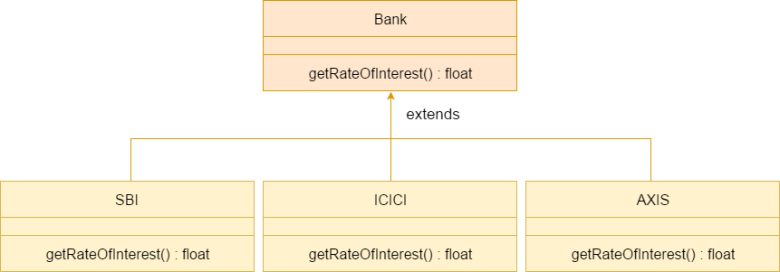
Example

Slide 80
class Bank{
int getRateOfInterest(){return 0;}
}
//Creating child classes.
class SBI extends Bank{
int getRateOfInterest(){return 8;}
}
class ICICI extends Bank{
int getRateOfInterest(){return 7;}
}
class AXIS extends Bank{
int getRateOfInterest(){return 9;}
}
//Test class to create objects and call the methods
class Test2{
public static void main(String args[]){
SBI s=new SBI();
ICICI i=new ICICI();
AXIS a=new AXIS();
System.out.println("SBI Rate of Interest: "+s.getRateOfInterest());
System.out.println("ICICI Rate of Interest: "+i.getRateOfInterest());
System.out.println("AXIS Rate of Interest: "+a.getRateOfInterest());
}
}

Slide 81
Q&A
Can we override static method?
No, a static method cannot be overridden. It can be proved by runtime polymorphism, so we will learn it later.
Why can we not override static method?
It is because the static method is bound with class whereas instance method is bound with an object. Static belongs to the class area, and an instance belongs to the heap area.
Can we override java main method?
No, because the main is a static method.

Slide 82
Difference between method overloading and method overriding
Sl | Method Overloading | Method Overriding
1) | Method overloading is used to increase the readability of the program. | Method overriding is used to provide the specific implementation of the method that is already provided by its super class.
2) | Method overloading is performed within class. | Method overriding occurs in two classes that have IS-A (inheritance) relationship.
3) | In case of method overloading, parameter must be different. | In case of method overriding, parameter must be same.
4) | Method overloading is the example of compile time polymorphism. | Method overriding is the example of run time polymorphism.
5) | In java, method overloading can't be performed by changing return type of the method only. Return type can be same or different in method overloading. But you must have to change the parameter. | Return type must be same or covariant

Slide 83
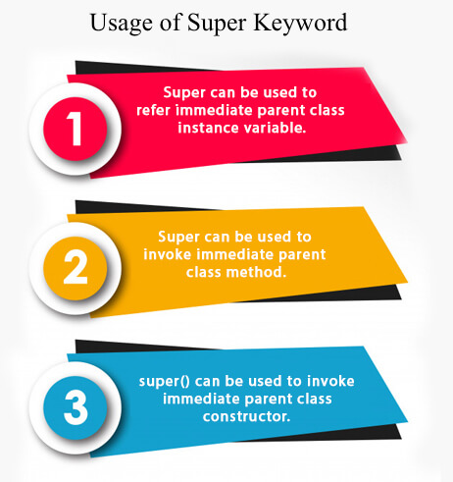
Super keyword
a reference variable which is used to refer immediate parent class object.
Whenever you create the instance of subclass, an instance of parent class is created implicitly which is referred by super reference variable.

Slide 84
super is used to refer immediate parent class instance variable.
use super keyword to access the data member or field of parent class. It is used if parent class and child class have same fields.
class A {
String var=“A”;
}
class B extends A {
String var=“B”;
void show() {
sop(super.var);
sop(var);
}
public class temp {
public static void main(String args[]) {
B b = new B();
b.show();
}
}

Slide 85
super can be used to invoke parent class method
The super keyword can also be used to invoke parent class method. It should be used if subclass contains the same method as parent class. In other words, it is used if method is overridden.
class A {
String var=“A”;
void show() {
sop(var);
}
}
class B extends A {
String var=“B”;
void show() {
super.show();;
sop(var);
}
public class temp {
public static void main(String args[]) {
B b = new B();
b.show();
}
}

Slide 86
super is used to invoke parent class constructor
The super keyword can also be used to invoke the parent class constructor.
class A {
String var=“A”;
A() {
var=“”;
}
void show() {
sop(var);
}
}
class B extends A {
String var=“B”;
B() {
super();
}
void show() {
super.show();;
sop(var);
}
public class temp {
public static void main(String args[]) {
B b = new B();
b.show();
}
}

Slide 87
Instance initializer Block
to initialize the instance data member/instance variable. It run each time when object of the class is created.
What is the use of instance initializer block? directly assign a value in instance data member
Why use instance initializer block? Suppose I have to perform some operations while assigning value to instance data member e.g. a for loop to fill a complex array or error handling etc.
class A {
int x;
A() {
System.out.println("x= "+x);
}
{ x=1; }
public static void main(String args[]){
A a1=new A();
A a2=new A();
}
}

Slide 88
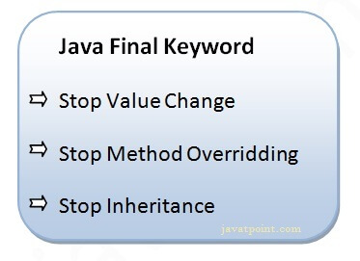
final word
The final keyword in java is used to restrict the user. The java final keyword can be used in many context. Final can be:
variable
method
class
The final keyword can be applied with the variables, a final variable that have no value it is called blank final variable or uninitialized final variable. It can be initialized in the constructor only. The blank final variable can be static also which will be initialized in the static block only

Slide 89
final variable
If you make any variable as final, you cannot change the value of final variable(It will be constant).
class Bike9{
final int speedlimit=90;//final variable
void run(){
speedlimit=400;
}
public static void main(String args[]){
Bike9 obj=new Bike9();
obj.run();
}
}//end

Slide 90
final method
If you make any method as final, you cannot override it.
class Bike{
final void run(){System.out.println("running");}
}
class Honda extends Bike{
void run(){System.out.println("running safely with 100kmph");}
public static void main(String args[]){
Honda honda= new Honda();
honda.run();
}
}

Slide 91
final class
If you make any class as final, you cannot extend it.
final class Bike{}
class Honda1 extends Bike{
void run(){System.out.println("running safely with 100kmph");
}
public static void main(String args[]){
Honda1 honda= new Honda1();
honda.run();
}
}

Slide 92
Q&A
Q) Is final method inherited?
Ans) Yes, final method is inherited but you cannot override it.
Q) What is blank or uninitialized final variable?
A final variable that is not initialized at the time of declaration is known as blank final variable.
Que) Can we initialize blank final variable?
Yes, but only in constructor.
A static final variable that is not initialized at the time of declaration is known as static blank final variable. It can be initialized only in static block.
Q) What is final parameter?
If you declare any parameter as final, you cannot change the value of it.
Q) Can we declare a constructor final?
No, because constructor is never inherited.

Slide 93
Contd...
three places to initialize the instance
method
constructor
block
What is invoked first, instance initializer block or constructor? initializer block
class A {
int x;
A() {
System.out.println("constructor is invoked");
}
{ System.out.println("instance initializer block invoked");}
public static void main(String args[]){
A a1=new A();
A a2=new A();
}
}

Slide 94
Rules for instance initializer block
The instance initializer block is created when instance of the class is created.
The instance initializer block is invoked after the parent class constructor is invoked (i.e. after super() constructor call).
The instance initializer block comes in the order in which they appear.
class A{
A(){
System.out.println("parent class constructor invoked");
}
}
class B2 extends A{
B2(){
super();
System.out.println("child class constructor invoked");
}
{System.out.println("instance initializer block is invoked");}
public static void main(String args[]){
B2 b=new B2();
}
}
class A{
A(){
System.out.println("parent class constructor invoked");
}
}
class B3 extends A{
B3(){
super();
System.out.println("child class constructor invoked");
}
B3(int a){
super();
System.out.println("child class constructor invoked "+a);
}
{System.out.println("instance initializer block is invoked");}
public static void main(String args[]){
B3 b1=new B3();
B3 b2=new B3(10);
}

Slide 95
Polymorphism
perform a single action in different ways.
Polymorphism is derived from 2 Greek words: poly and morphs.
The word "poly" means many and "morphs" means forms. So polymorphism means many forms.
There are two types of polymorphism in Java: compile-time polymorphism and runtime polymorphism. We can perform polymorphism in java by method overloading and method overriding.
If you overload a static method in Java, it is the example of compile time polymorphism.

Slide 96
Runtime Polymorphism/Dynamic method dispatch
a process in which a call to an overridden method is resolved at runtime rather than compile-time.
In this process, an overridden method is called through the reference variable of a superclass. The determination of the method to be called is based on the object being referred to by the reference variable.
class Shape{
void draw(){System.out.println("drawing...");}
}
class Rectangle extends Shape{
void draw(){System.out.println("drawing rectangle...");}
}
class Circle extends Shape{
void draw(){System.out.println("drawing circle...");}
}
class Triangle extends Shape{
void draw(){System.out.println("drawing triangle...");}
}
class TestPolymorphism2{
public static void main(String args[]){
Shape s;
s=new Rectangle();
s.draw();
s=new Circle();
s.draw();
s=new Triangle();
s.draw();
}
}

Slide 97
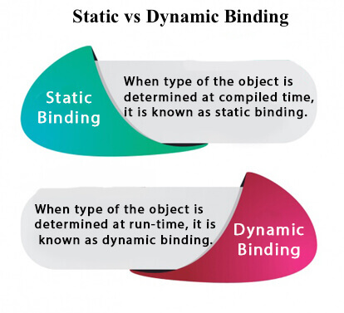
Static Binding and Dynamic Binding
Connecting a method call to the method body is known as binding.
There are two types of binding
Static Binding (also known as Early Binding).
Dynamic Binding (also known as Late Binding).

Slide 98
Static binding example
class A{
private void show(){
System.out.println("dog is eating...");
}
public static void main(String args[]){
A a=new A();
a.show();
}
}

Slide 99
Dynamic binding example
class A{
void show(){
System.out.println("A's msg...");
}
}
class B extends A {
void show(){
System.out.println("B's msg...");
}
public static void main(String args[]){
A a=new B();
a.show();
}
}

Slide 100
Abstraction
A class which is declared with the abstract keyword is known as an abstract class in Java. It can have abstract and non-abstract methods (method with the body).
Abstraction is a process of hiding the implementation details and showing only functionality to the user.
Another way, it shows only essential things to the user and hides the internal details,
Ways to achieve Abstraction
There are two ways to achieve abstraction in java
Abstract class (0 to 100%)
Interface (100%)

Slide 101
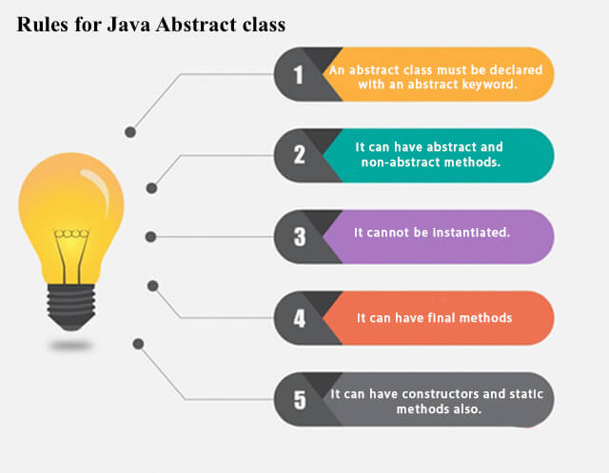
Rules

Slide 102
Abstract Method
A method which is declared as abstract and does not have implementation is known as an abstract method.
Example of abstract method
abstract void printStatus();//no method body and abstract
A factory method is a method that returns the instance of the class.

Slide 103
Example
abstract class Shape{
Shape() {}
abstract void draw();
}
void area() {}
//In real scenario, implementation is provided by others i.e. unknown by end user
class Rectangle extends Shape{
void draw(){System.out.println("drawing rectangle");}
}
class Circle1 extends Shape{
void draw(){System.out.println("drawing circle");}
}
//In real scenario, method is called by programmer or user
class TestAbstraction1{
public static void main(String args[]){
Shape s=new Circle1();//In a real scenario, object is provided through method, e.g., getShape() method
s.draw();
}
}

Slide 104
Interface
An interface in Java is a blueprint of a class. It has static constants and abstract methods.
The interface in Java is a mechanism to achieve abstraction. There can be only abstract methods in the Java interface, not method body. It is used to achieve abstraction and multiple inheritance in Java.
interfaces can have abstract methods and variables. It cannot have a method body.
Java Interface also represents the IS-A relationship.
It cannot be instantiated just like the abstract class.
An interface is declared by using the interface keyword. It provides total abstraction; means all the methods in an interface are declared with the empty body, and all the fields are public, static and final by default. A class that implements an interface must implement all the methods declared in the interface.
Interface fields are public, static and final by default, and the methods are public and abstract.

Slide 105
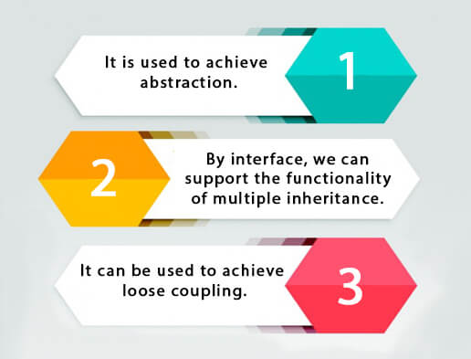
reasons to use interface

Slide 106
Example
//Interface declaration: by first user
interface Drawable{
void draw();
}
//Implementation: by second user
class Rectangle implements Drawable{
public void draw(){System.out.println("drawing rectangle");}
}
class Circle implements Drawable{
public void draw(){System.out.println("drawing circle");}
}
//Using interface: by third user
class TestInterface1{
public static void main(String args[]){
Drawable d=new Circle();//In real scenario, object is provided by method e.g. getDrawable()
d.draw();
}}

Slide 107
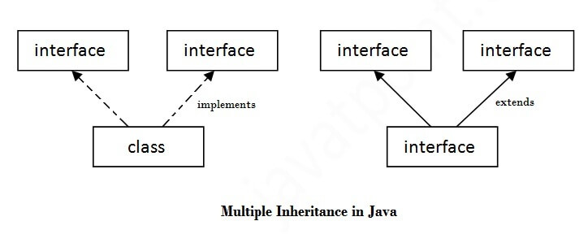
Multiple inheritance in Java by interface
If a class implements multiple interfaces, or an interface extends multiple interfaces, it is known as multiple inheritance.

Slide 108
Example
interface Printable{
void print();
}
interface Showable{
void show();
}
class A7 implements Printable,Showable{
public void print(){System.out.println("Hello");}
public void show(){System.out.println("Welcome");}
public static void main(String args[]){
A7 obj = new A7();
obj.print();
obj.show();
}
}

Slide 109
Interface inheritance
interface Printable{
void print();
}
interface Showable extends Printable{
void show();
}
class TestInterface4 implements Showable{
public void print(){System.out.println("Hello");}
public void show(){System.out.println("Welcome");}
public static void main(String args[]){
TestInterface4 obj = new TestInterface4();
obj.print();
obj.show();
}

Slide 110
Nested Interface
An interface can have another interface which is known as a nested interface.
interface printable{
void print();
interface MessagePrintable{
void msg();
}
}

Slide 111
Difference between abstract class and interface
bstract class | Interface
1) Abstract class can have abstract and non-abstract methods. | Interface can have only abstract methods. Since Java 8, it can have default and static methods also.
2) Abstract class doesn't support multiple inheritance. | Interface supports multiple inheritance.
3) Abstract class can have final, non-final, static and non-static variables. | Interface has only static and final variables.
4) Abstract class can provide the implementation of interface. | Interface can't provide the implementation of abstract class.
5) The abstract keyword is used to declare abstract class. | The interface keyword is used to declare interface.
6) An abstract class can extend another Java class and implement multiple Java interfaces. | An interface can extend another Java interface only.
7) An abstract class can be extended using keyword "extends". | An interface can be implemented using keyword "implements".
8) A Java abstract class can have class members like private, protected, etc. | Members of a Java interface are public by default.
9)Example: public abstract class Shape{ public abstract void draw(); } | Example: public interface Drawable{ void draw(); }

Slide 112
Package
A java package is a group of similar types of classes, interfaces and sub-packages.
Package in java can be categorized in two form, built-in package and user-defined package.
There are many built-in packages such as java, lang, awt, javax, swing, net, io, util, sql etc.
Advantage of Java Package
1) Java package is used to categorize the classes and interfaces so that they can be easily maintained.
2) Java package provides access protection.
3) Java package removes naming collision.

Slide 113
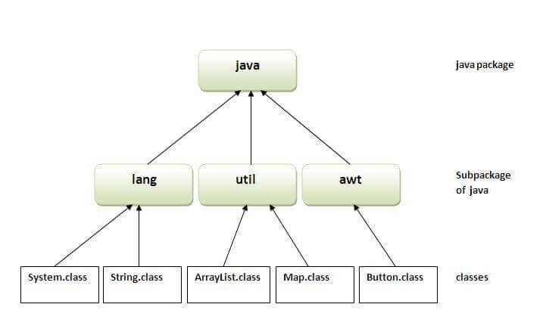
Pre defined packages
Import statement is used to include package in java applications.
Import java.*;
How to access package from another package?
There are three ways to access the package from outside the package.
import package.*;
import package.classname;
fully qualified name.

Slide 114
User defined package
The package keyword is used to create a package in java.
//save as Simple.java
package mypack;
public class Simple{
public static void main(String args[]){
System.out.println("Welcome to package");
}
}

Slide 115
Using packagename.*
If you use package.* then all the classes and interfaces of this package will be accessible but not subpackages.
The import keyword is used to make the classes and interface of another package accessible to the current package.
//save by A.java
package pack;
public class A{
public void msg(){System.out.println("Hello");}
}
package mypack;
import pack.*;
class B{
public static void main(String args[]){
A obj = new A();
obj.msg();
}
}

Slide 116
Using packagename.classname
If you import package.classname then only declared class of this package will be accessible.
package pack;
public class A{
public void msg(){System.out.println("Hello");}
}
//save by B.java
package mypack;
import pack.A;
class B{
public static void main(String args[]){
A obj = new A();
obj.msg();
}
}

Slide 117
Using fully qualified name
If you use fully qualified name then only declared class of this package will be accessible. Now there is no need to import. But you need to use fully qualified name every time when you are accessing the class or interface.
It is generally used when two packages have same class name e.g. java.util and java.sql packages contain Date class.
//save by A.java
package pack;
public class A{
public void msg(){System.out.println("Hello");}
} //save by B.java
package mypack;
class B{
public static void main(String args[]){
pack.A obj = new pack.A();//using fully qualified name
obj.msg();
}
}

Slide 118
Sub package
Package inside the package is called the subpackage. It should be created to categorize the package further.
package com.javatpoint.core;
class Simple{
public static void main(String args[]){
System.out.println("Hello subpackage");
}
}
To Compile: javac -d . Simple.java
To Run: java com.javatpoint.core.Simple

Slide 119
Array
an array is a collection of similar type of elements which has contiguous memory location.
Java array is an object which contains elements of a similar data type. Additionally, The elements of an array are stored in a contiguous memory location. It is a data structure where we store similar elements. We can store only a fixed set of elements in a Java array.
Array in Java is index-based, the first element of the array is stored at the 0th index, 2nd element is stored on 1st index and so on.
array is an object of a dynamically generated class. Java array inherits the Object class, and implements the Serializable as well as Cloneable interfaces. We can store primitive values or objects in an array in Java.
Advantages
Code Optimization: It makes the code optimized, we can retrieve or sort the data efficiently.
Random access: We can get any data located at an index position.
Disadvantages
Size Limit: We can store only the fixed size of elements in the array. It doesn't grow its size at runtime. To solve this problem, collection framework is used in Java which grows automatically.

Slide 120
Types of Array
There are two types of array.
Single Dimensional Array
Multidimensional Array
Single Dimensional Array in Java
Syntax to Declare an Array in Java
dataType[] arr; (or)
dataType []arr; (or)
dataType arr[];
Instantiation of an Array in Java
arrayRefVar=new datatype[size];

Slide 121
Example
class Testarray{
public static void main(String args[]){
int a[]=new int[5];//declaration and instantiation
a[0]=10;//initialization
a[1]=20;
a[2]=70;
a[3]=40;
a[4]=50;
//traversing array
for(int i=0;i<a.length;i++)//length is the property of array
System.out.println(a[i]);
}}

Slide 122
Declaration, Instantiation and Initialization For-each Loop
class Testarray1{
public static void main(String args[]){
int a[]={33,3,4,5};//declaration, instantiation and initialization
//printing array
for(int i=0;i<a.length;i++)//length is the property of array
System.out.println(a[i]);
for(int i:arr)
System.out.println(i);
}
}

Slide 123
Passing Array to a Method
class Testarray2{
//creating a method which receives an array as a parameter
static void min(int arr[]){
int min=arr[0];
for(int i=1;i<arr.length;i++)
if(min>arr[i])
min=arr[i];
System.out.println(min);
}
public static void main(String args[]){
int a[]={33,3,4,5};//declaring and initializing an array
min(a);//passing array to method
}}

Slide 124
Anonymous Array
public class TestAnonymousArray{
//creating a method which receives an array as a parameter
static void printArray(int arr[]){
for(int i=0;i<arr.length;i++)
System.out.println(arr[i]);
}
public static void main(String args[]){
printArray(new int[]{10,22,44,66});//passing anonymous array to method
}
}

Slide 125
Returning Array from the Method
class TestReturnArray{
//creating method which returns an array
static int[] get(){
return new int[]{10,30,50,90,60};
}
public static void main(String args[]){
//calling method which returns an array
int arr[]=get();
//printing the values of an array
for(int i=0;i<arr.length;i++)
System.out.println(arr[i]);
}
}

Slide 126
Multidimensional Array
Declaration
dataType[][] arrayRefVar; (or)
dataType [][]arrayRefVar; (or)
dataType arrayRefVar[][]; (or)
dataType []arrayRefVar[];
Initialize
int[][] arr=new int[3][3];//3 row and 3 column
class Testarray3{
public static void main(String args[]){
//declaring and initializing 2D array
int arr[][]={{1,2,3},{2,4,5},{4,4,5}};
//printing 2D array
for(int i=0;i<3;i++){
for(int j=0;j<3;j++){
System.out.print(arr[i][j]+" ");
}
System.out.println();
}
}
}

Slide 127
Jagged Array
If we are creating odd number of columns in a 2D array, it is known as a jagged array. In other words, it is an array of arrays with different number of columns.
class TestJaggedArray{
public static void main(String[] args){
//declaring a 2D array with odd columns
int arr[][] = new int[3][];
arr[0] = new int[3];
arr[1] = new int[4];
arr[2] = new int[2];
//initializing a jagged array
int count = 0;
for (int i=0; i<arr.length; i++)
for(int j=0; j<arr[i].length; j++)
arr[i][j] = count++;
//printing the data of a jagged array
for (int i=0; i<arr.length; i++){
for (int j=0; j<arr[i].length; j++){
System.out.print(arr[i][j]+" ");
}
System.out.println();//new line
}
}
}

Slide 128
Access Modifiers
There are two types of modifiers in Java: access modifiers and non-access modifiers.
The access modifiers in Java specifies the accessibility or scope of a field, method, constructor, or class. We can change the access level of fields, constructors, methods, and class by applying the access modifier on it.
There are four types of Java access modifiers:
Private: The access level of a private modifier is only within the class. It cannot be accessed from outside the class.
Default: The access level of a default modifier is only within the package. It cannot be accessed from outside the package. If you do not specify any access level, it will be the default.
Protected: The access level of a protected modifier is within the package and outside the package through child class. If you do not make the child class, it cannot be accessed from outside the package.
Public: The access level of a public modifier is everywhere. It can be accessed from within the class, outside the class, within the package and outside the package.
There are many non-access modifiers, such as static, abstract, synchronized, native, volatile, transient, etc.

Slide 129
Java Access Modifiers
Access Modifier | within class | within package | outside package by subclass only | outside package
Private | Y | N | N | N
Default | Y | Y | N | N
Protected | Y | Y | Y | N
Public | Y | Y | Y | Y

Slide 130
Private
The private access modifier is accessible only within the class.
n this example, we have created two classes A and Simple. A class contains private data member and private method. We are accessing these private members from outside the class, so there is a compile-time error.
any class constructor private, you cannot create the instance of that class from outside the class.
class A{
private int a;
private A(){}//private constructor
void msg(){System.out.println("Hello java");}
}
public class Simple{
public static void main(String args[]){
A obj=new A();//Compile Time Error
}
}

Slide 131
Default
If you don't use any modifier, it is treated as default by default. The default modifier is accessible only within package. It cannot be accessed from outside the package. It provides more accessibility than private. But, it is more restrictive than protected, and public.
//save by A.java
package pack;
class A{
void msg(){System.out.println("Hello");}
}
//save by B.java
package mypack;
import pack.*;
class B{
public static void main(String args[]){
A obj = new A();//Compile Time Error
obj.msg();//Compile Time Error
}
}

Slide 132
Protected
The protected access modifier is accessible within package and outside the package but through inheritance only.
The protected access modifier can be applied on the data member, method and constructor. It can't be applied on the class.
It provides more accessibility than the default modifer.
//save by A.java
package pack;
public class A{
protected void msg(){System.out.println("Hello");}
}
//save by B.java
package mypack;
import pack.*;
class B extends A{
public static void main(String args[]){
B obj = new B();
obj.msg();
}
}

Slide 133
Public
The public access modifier is accessible everywhere. It has the widest scope among all other modifiers.
//save by A.java
package pack;
public class A{
public void msg(){System.out.println("Hello");}
}
//save by B.java
package mypack;
import pack.*;
class B{
public static void main(String args[]){
A obj = new A();
obj.msg();
}
}

Slide 134
Access Modifiers with Method Overriding
If you are overriding any method, overridden method (i.e. declared in subclass) must not be more restrictive.
class A{
protected void msg(){System.out.println("Hello java");}
}
public class Simple extends A{
void msg(){System.out.println("Hello java");}//C.T.Error
public static void main(String args[]){
Simple obj=new Simple();
obj.msg();
}
}

Slide 135
Encapsulation
Encapsulation in Java is a process of wrapping code and data together into a single unit, for example, a capsule which is mixed of several medicines.
We can create a fully encapsulated class in Java by making all the data members of the class private. Now we can use setter and getter methods to set and get the data in it.
The Java Bean class is the example of a fully encapsulated class.
Advantage of Encapsulation in Java
By providing only a setter or getter method, you can make the class read-only or write-only. In other words, you can skip the getter or setter methods.
It provides you the control over the data. Suppose you want to set the value of id which should be greater than 100 only, you can write the logic inside the setter method. You can write the logic not to store the negative numbers in the setter methods.
It is a way to achieve data hiding in Java because other class will not be able to access the data through the private data members.
The encapsulate class is easy to test. So, it is better for unit testing.
The standard IDE's are providing the facility to generate the getters and setters. So, it is easy and fast to create an encapsulated class in Java.

Slide 136
Example
class Account {
//private data members
private long acc_no;
private String name,email;
private float amount;
//public getter and setter methods
public long getAcc_no() {
return acc_no;
}
public void setAcc_no(long acc_no) {
this.acc_no = acc_no;
}
public String getName() {
return name;
}
public void setName(String name) {
this.name = name;
}
public String getEmail() {
return email;
}
public void setEmail(String email) {
this.email = email;
}
public float getAmount() {
return amount;
}
public void setAmount(float amount) {
this.amount = amount;
}
}
public class TestEncapsulation {
public static void main(String[] args) {
//creating instance of Account class
Account acc=new Account();
//setting values through setter methods
acc.setAcc_no(7560504000L);
acc.setName("Sonoo Jaiswal");
acc.setEmail("sonoojaiswal@javatpoint.com");
acc.setAmount(500000f);
//getting values through getter methods
System.out.println(acc.getAcc_no()+" "+acc.getName()+" "+acc.getEmail()+" "+acc.getAmount());
}
}

Slide 137
Exception
an abnormal condition.
In Java, an exception is an event that disrupts the normal flow of the program. It is an object which is thrown at runtime.
Exception Handling
a mechanism to handle runtime errors such as ClassNotFoundException, IOException, SQLException, RemoteException, etc.
class test {
public static void main(String ags[]) {
int a = 5,b=0;
int c = a/b; // error occur
sop(c);
}
}

Slide 138
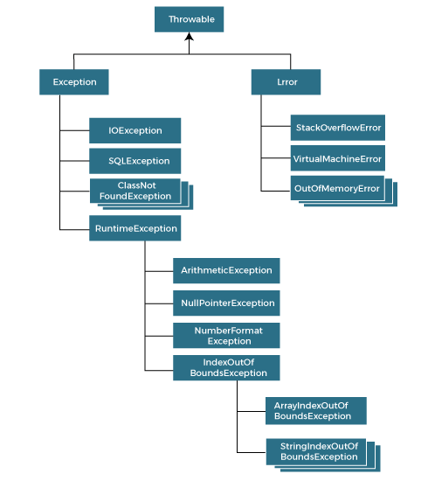
Hierarchy of Java Exception classes

Slide 139
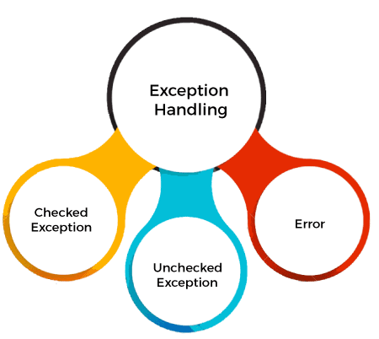
Types of Java Exceptions
1) Checked Exception
The classes that directly inherit the Throwable class except RuntimeException and Error are known as checked exceptions. For example, IOException, SQLException, etc. Checked exceptions are checked at compile-time.
2) Unchecked Exception
The classes that inherit the RuntimeException are known as unchecked exceptions. For example, ArithmeticException, NullPointerException, ArrayIndexOutOfBoundsException, etc. Unchecked exceptions are not checked at compile-time, but they are checked at runtime.
3) Error
Error is irrecoverable. Some example of errors are OutOfMemoryError, VirtualMachineError, AssertionError etc.

Slide 140
Exception Keywords
Keyword | Description
try | The "try" keyword is used to specify a block where we should place an exception code. It means we can't use try block alone. The try block must be followed by either catch or finally.
catch | The "catch" block is used to handle the exception. It must be preceded by try block which means we can't use catch block alone. It can be followed by finally block later.
finally | The "finally" block is used to execute the necessary code of the program. It is executed whether an exception is handled or not.
throw | The "throw" keyword is used to throw an exception.
throws | The "throws" keyword is used to declare exceptions. It specifies that there may occur an exception in the method. It doesn't throw an exception. It is always used with method signature.

Slide 141
Common Scenarios of Java Exceptions
1) A scenario where ArithmeticException occurs
If we divide any number by zero, there occurs an ArithmeticException.
int a=50/0;//ArithmeticException
2) A scenario where NullPointerException occurs
If we have a null value in any variable, performing any operation on the variable throws a NullPointerException.
String s=null;
System.out.println(s.length());//NullPointerException
3) A scenario where NumberFormatException occurs
If the formatting of any variable or number is mismatched, it may result into NumberFormatException. Suppose we have a string variable that has characters; converting this variable into digit will cause NumberFormatException.
String s="abc";
int i=Integer.parseInt(s);//NumberFormatException
4) A scenario where ArrayIndexOutOfBoundsException occurs
When an array exceeds to it's size, the ArrayIndexOutOfBoundsException occurs. there may be other reasons to occur ArrayIndexOutOfBoundsException. Consider the following statements.
int a[]=new int[5];
a[10]=50; //ArrayIndexOutOfBoundsException

Slide 142
Thread

